Slide 1
Machine Learning with WEKA

Slide 2
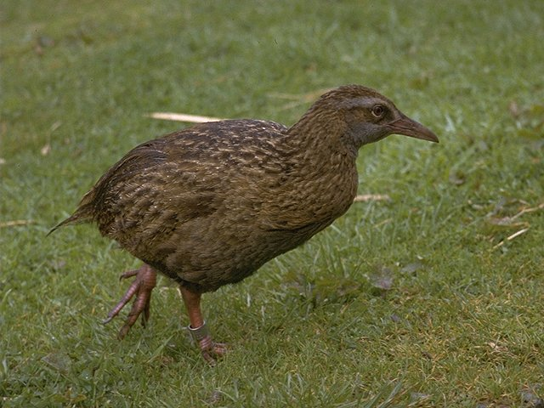
WEKA: the bird
The Weka or woodhen (Gallirallus australis) is an endemic bird of New Zealand. (Source: WikiPedia)
Copyright: Martin Kramer (mkramer@wxs.nl)

Slide 3
WEKA: the software
Machine learning/data mining software written in Java (distributed under the GNU Public License)
Used for research, education, and applications
Complements “Data Mining” by Witten & Frank
Main features:
  Comprehensive set of data pre-processing tools, learning algorithms and evaluation methods
  Graphical user interfaces (incl. data visualization)
  Environment for comparing learning algorithms

Slide 4
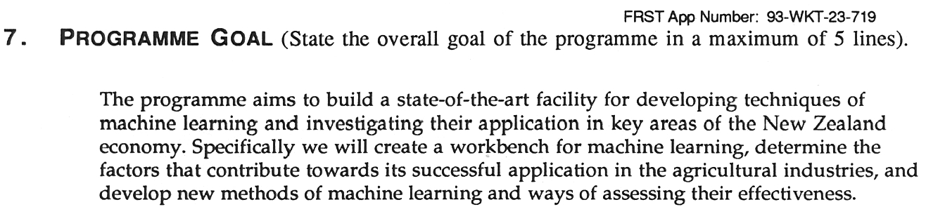
History
Project funded by the NZ government since 1993
  Develop state-of-the art workbench of data mining tools
  Explore fielded applications
  Develop new fundamental methods

Slide 5
History (2)
Late 1992 - funding was applied for by Ian Witten
1993 - development of the interface and infrastructure
  WEKA acronym coined by Geoff Holmes
  WEKA’s file format “ARFF” was created by Andrew Donkin
  ARFF was rumored to stand for Andrew’s Ridiculous File Format
Sometime in 1994 - first internal release of WEKA
  TCL/TK user interface + learning algorithms written mostly in C
  Very much beta software
  Changes for the b1 release included (among others):
    “Ambiguous and Unsupported menu commands removed.”
    “Crashing processes handled (in most cases :-)”
October 1996 - first public release: WEKA 2.1

Slide 6
History (3)
July 1997 - WEKA 2.2
  Schemes: 1R, T2, K*, M5, M5Class, IB1-4, FOIL, PEBLS, support for C5
  Included a facility (based on Unix makefiles) for configuring and running large scale experiments
Early 1997 - decision was made to rewrite WEKA in Java
  Originated from code written by Eibe Frank for his PhD
  Originally codenamed JAWS (JAva Weka System)
May 1998 - WEKA 2.3
  Last release of the TCL/TK-based system
Mid 1999 - WEKA 3 (100% Java) released
  Version to complement the Data Mining book
  Development version (including GUI)

Slide 7
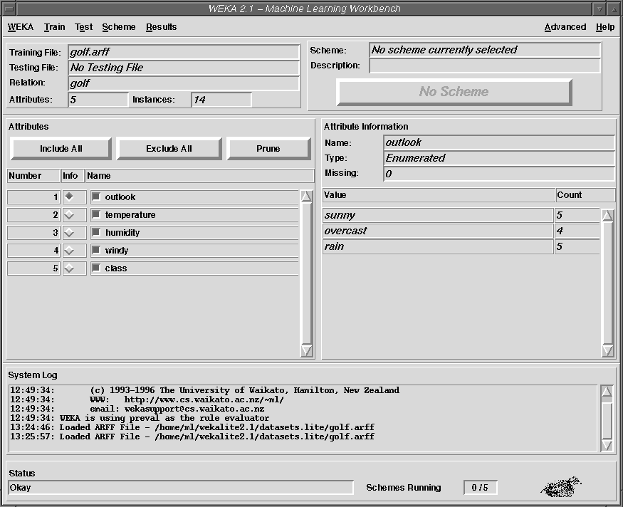
The GUI back then…
TCL/TK interface of Weka 2.1

Slide 8
WEKA: versions
There are several versions of WEKA:
  WEKA 3.4: “book version” compatible with description in data mining book
  WEKA 3.5.5: “development version” with lots of improvements
This talk is based on a nightly snapshot of WEKA 3.5.5 (12-Feb-2007)

Slide 9
WEKA only deals with “flat” files
@relation heart-disease-simplified
@attribute age numeric
@attribute sex { female, male}
@attribute chest_pain_type { typ_angina, asympt, non_anginal, atyp_angina}
@attribute cholesterol numeric
@attribute exercise_induced_angina { no, yes}
@attribute class { present, not_present}
@data
63,male,typ_angina,233,no,not_present
67,male,asympt,286,yes,present
67,male,asympt,229,yes,present
38,female,non_anginal,?,no,not_present
...
Flat file in
ARFF format

Slide 10
WEKA only deals with “flat” files
@relation heart-disease-simplified
@attribute age numeric
@attribute sex { female, male}
@attribute chest_pain_type { typ_angina, asympt, non_anginal, atyp_angina}
@attribute cholesterol numeric
@attribute exercise_induced_angina { no, yes}
@attribute class { present, not_present}
@data
63,male,typ_angina,233,no,not_present
67,male,asympt,286,yes,present
67,male,asympt,229,yes,present
38,female,non_anginal,?,no,not_present
...
numeric attribute
nominal attribute

Slide 11
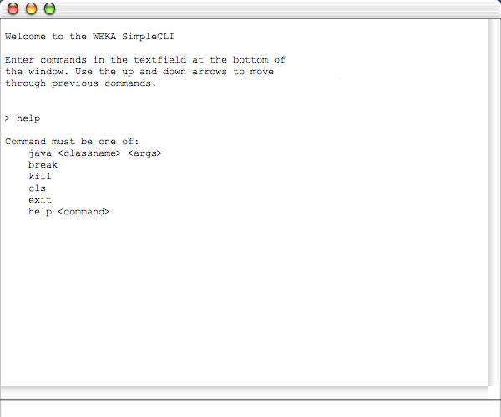
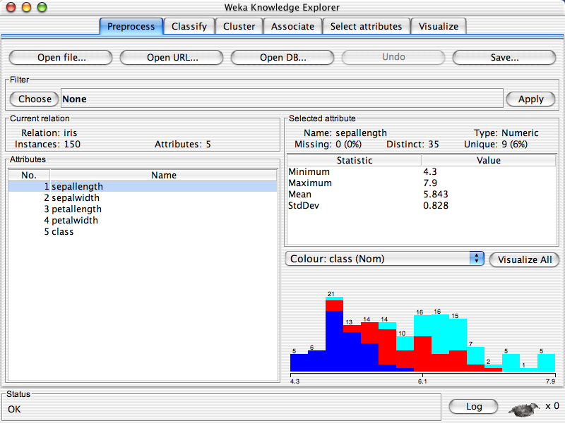
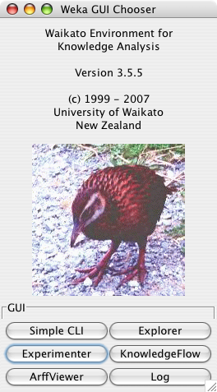
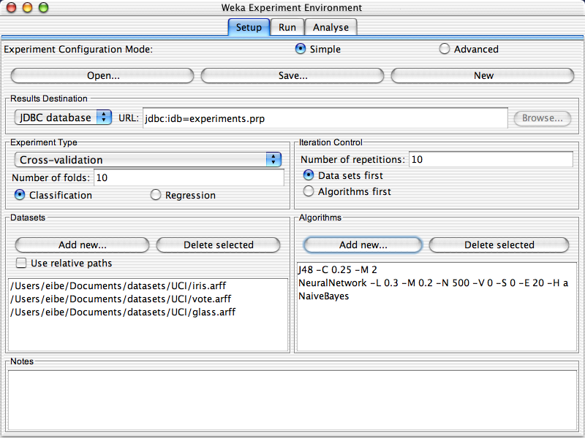
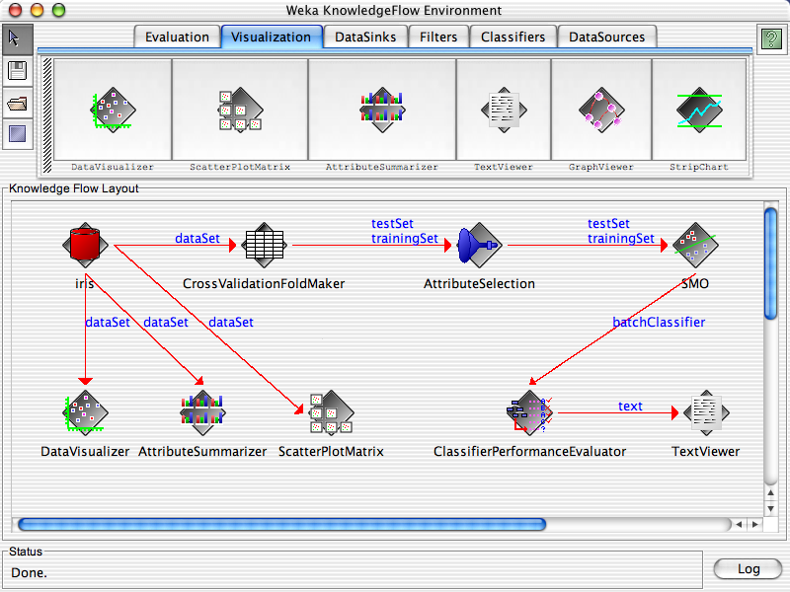
java weka.gui.GUIChooser

Slide 14
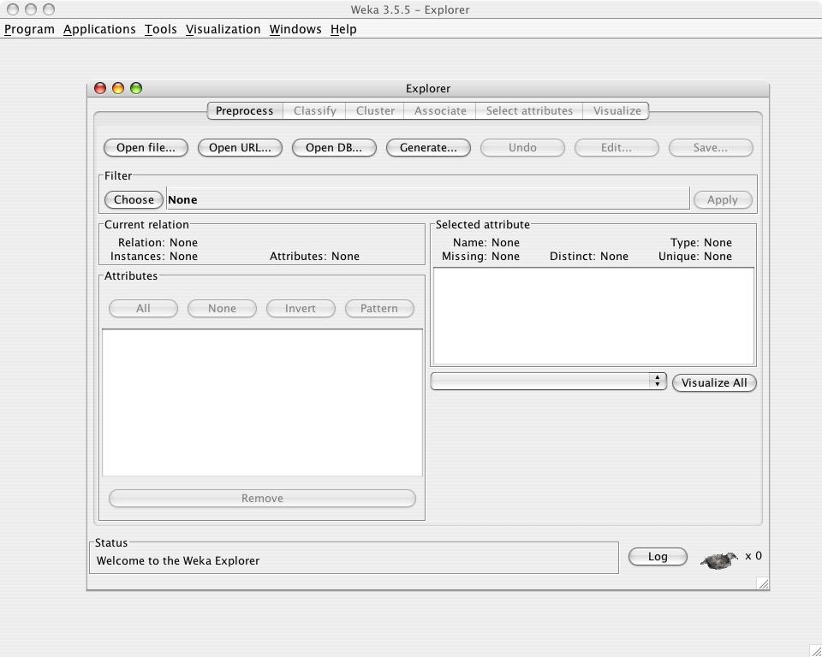
java -jar weka.jar

Slide 15
Explorer: pre-processing the data
Data can be imported from a file in various formats: ARFF, CSV, C4.5, binary
Data can also be read from a URL or from an SQL database (using JDBC)
Pre-processing tools in WEKA are called “filters”
WEKA contains filters for:
  Discretization, normalization, resampling, attribute selection, transforming and combining attributes, …

Slide 16
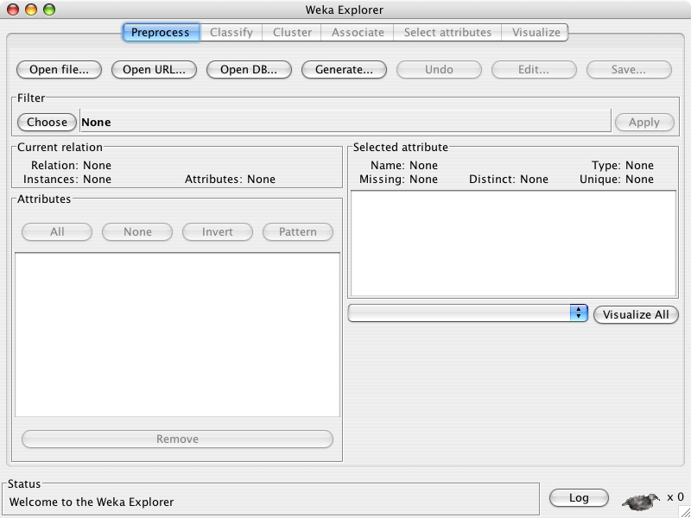

Slide 18
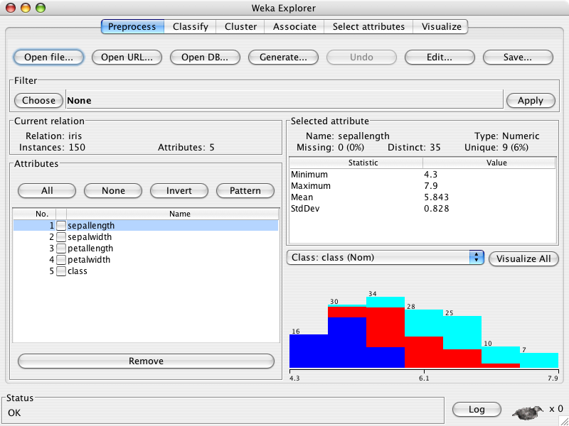

Slide 20
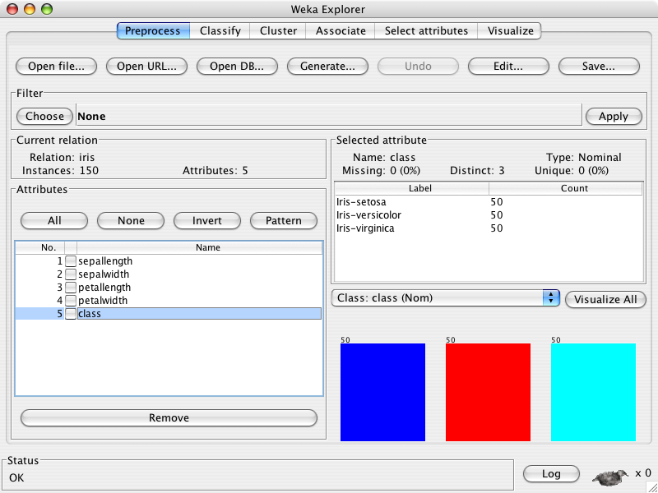

Slide 22
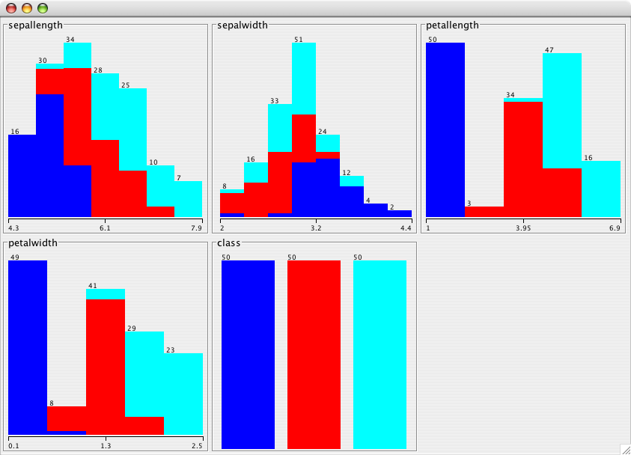

Slide 23
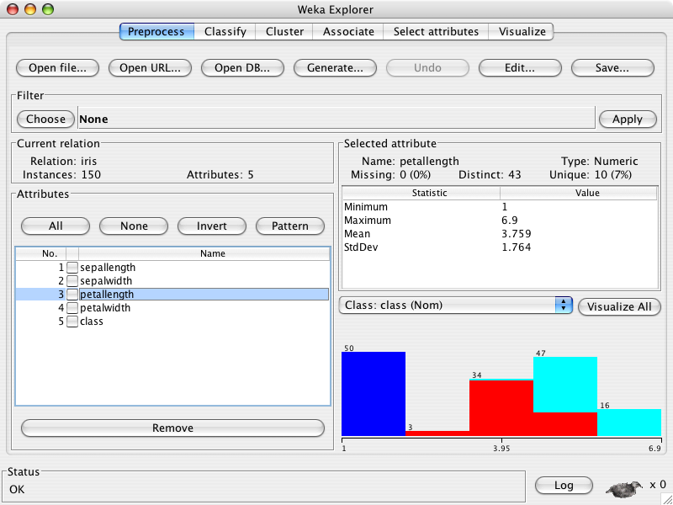

Slide 25
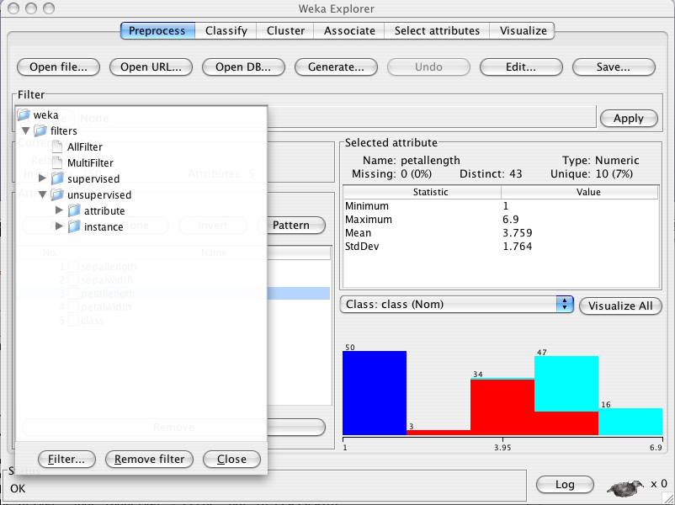

Slide 27
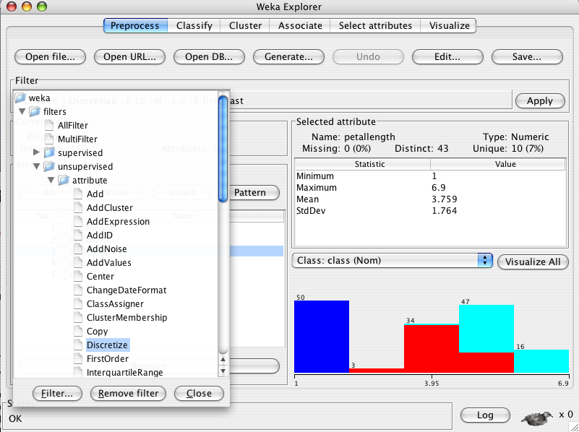

Slide 28


Slide 30
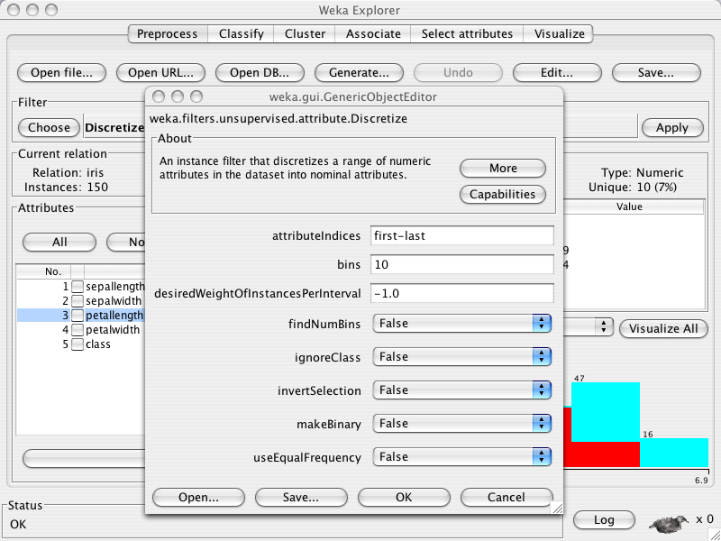

Slide 32
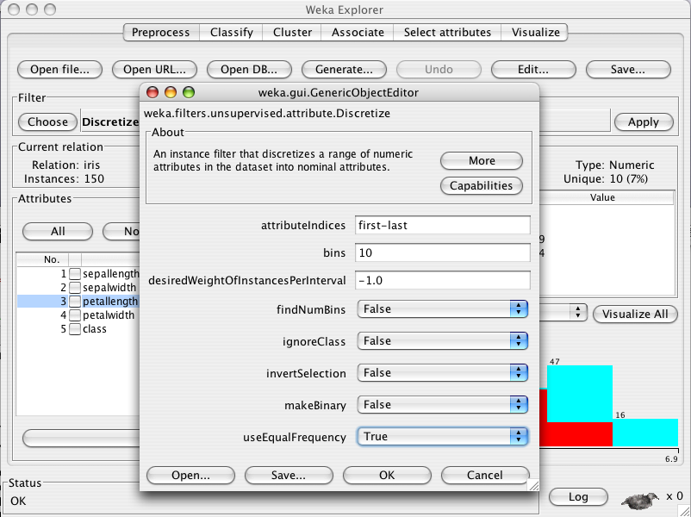

Slide 34


Slide 36
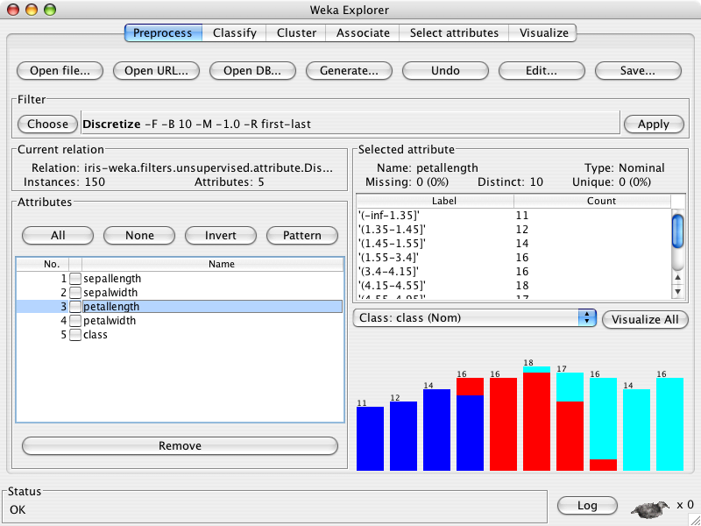

Slide 37
Explorer: building “classifiers”
Classifiers in WEKA are models for predicting nominal or numeric quantities
Implemented learning schemes include:
  Decision trees and lists, instance-based classifiers, support vector machines, multi-layer perceptrons, logistic regression, Bayes’ nets, …
“Meta”-classifiers include:
  Bagging, boosting, stacking, error-correcting output codes, locally weighted learning, …

Slide 38
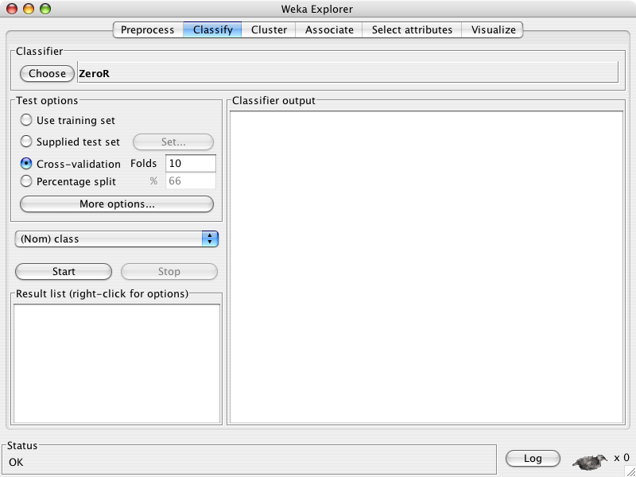

Slide 40
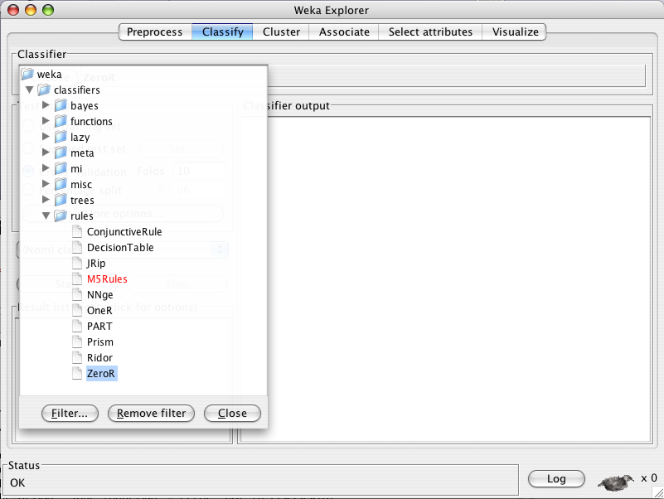

Slide 41
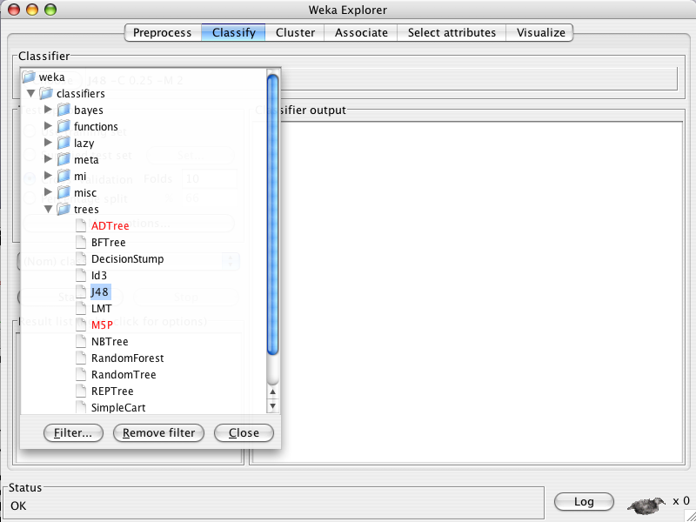

Slide 42
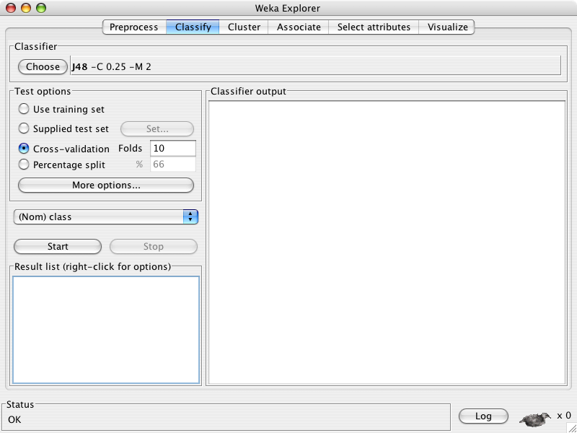

Slide 44
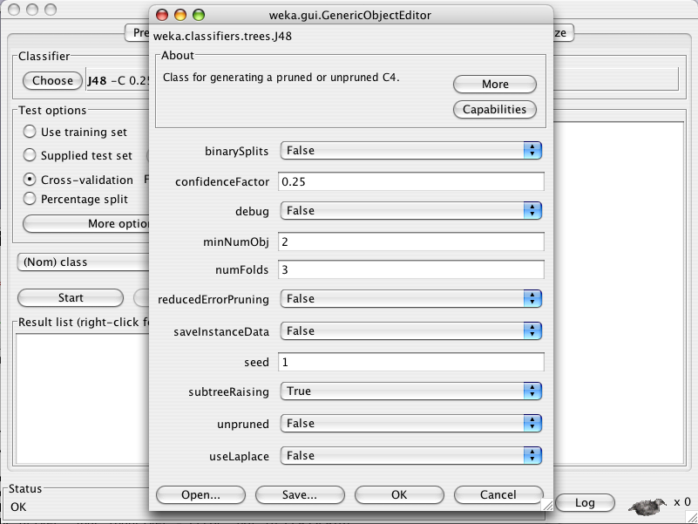

Slide 48
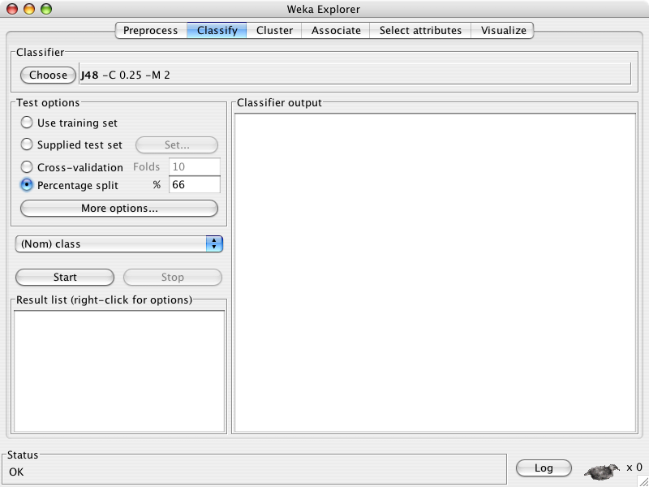

Slide 50
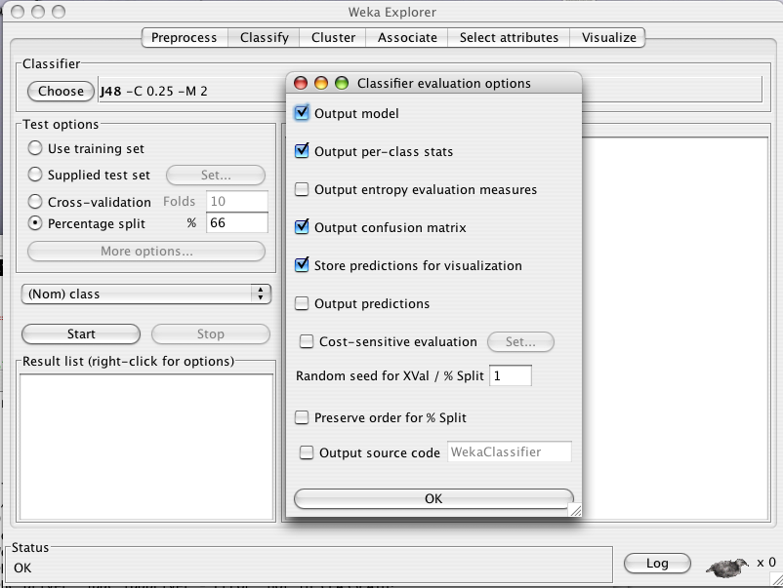

Slide 54
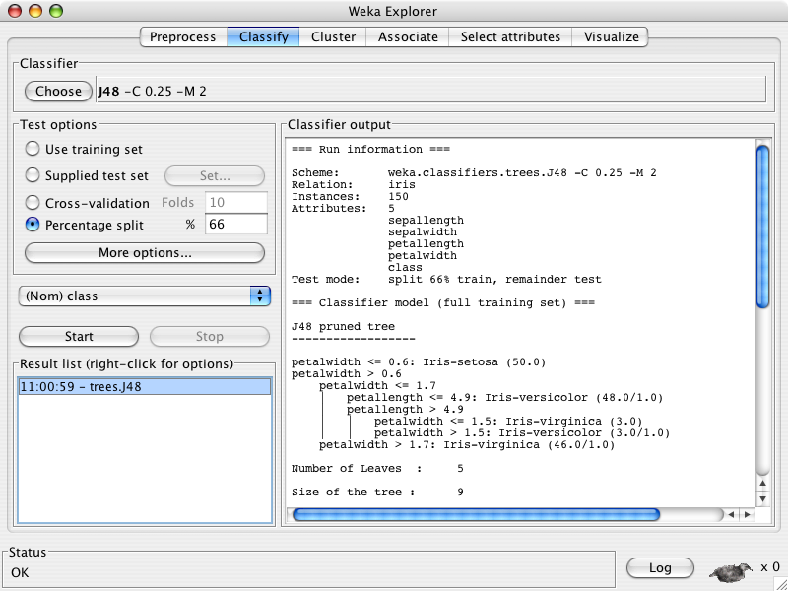

Slide 56
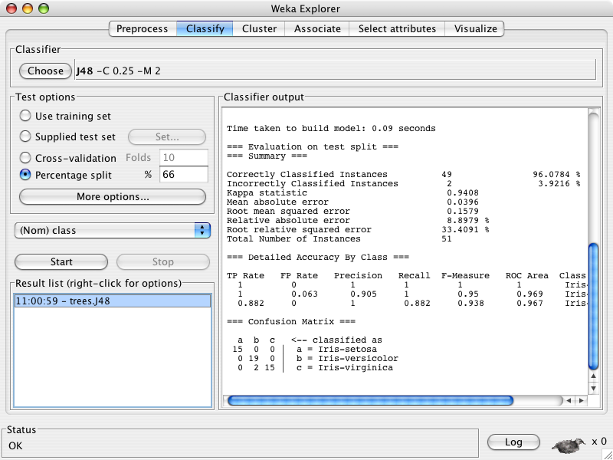

Slide 58
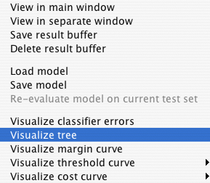

Slide 59
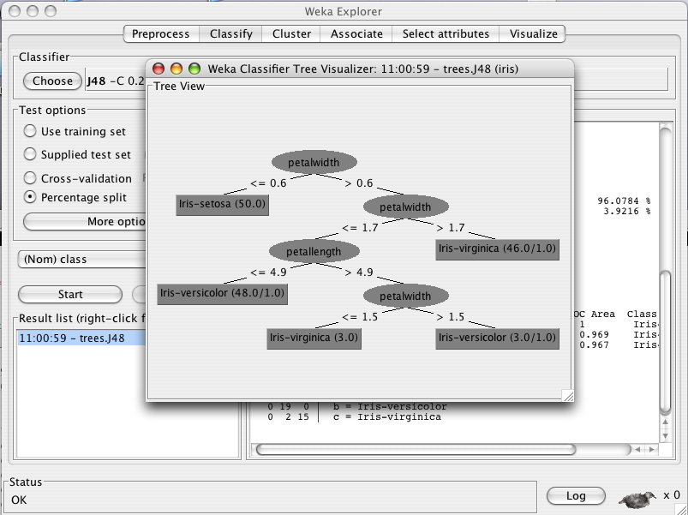

Slide 60
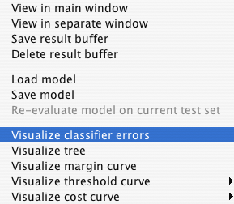

Slide 61
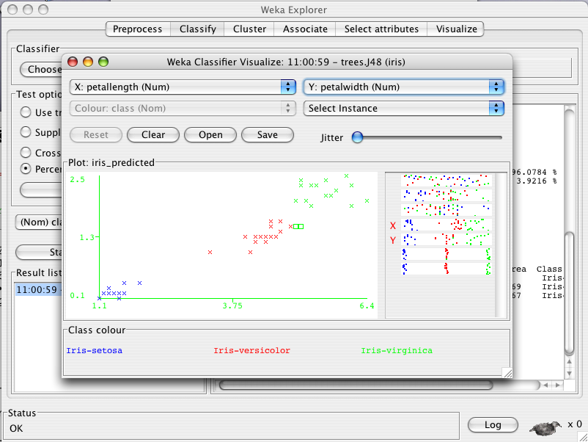

Slide 64
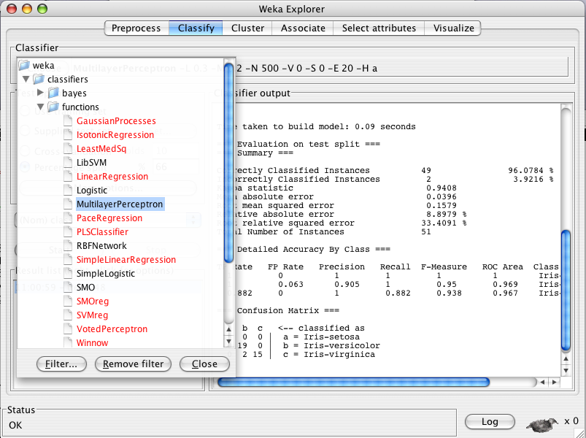

Slide 65
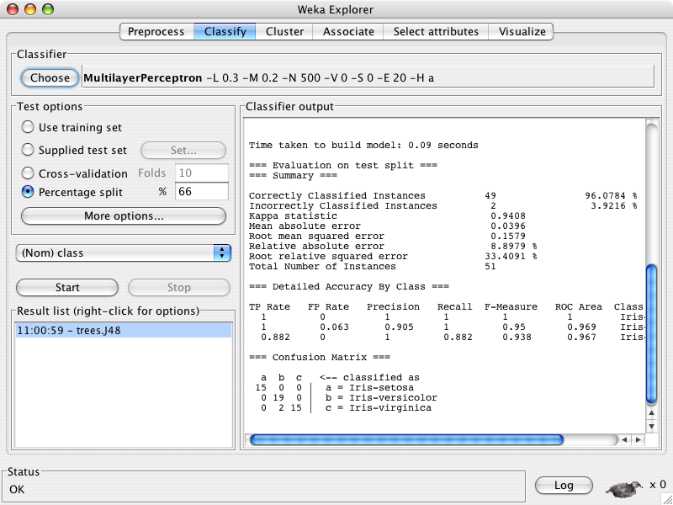

Slide 66
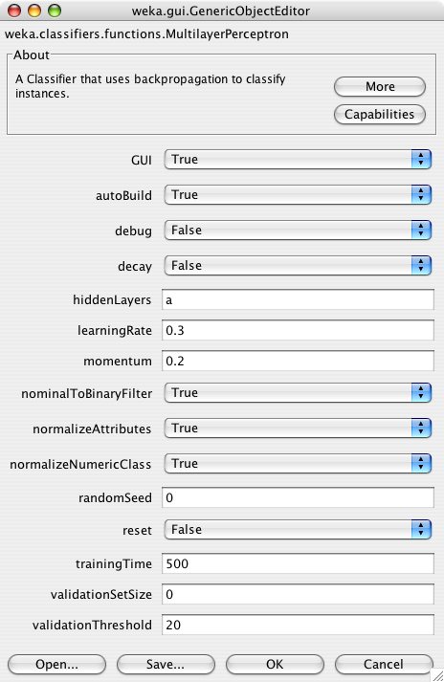

Slide 68
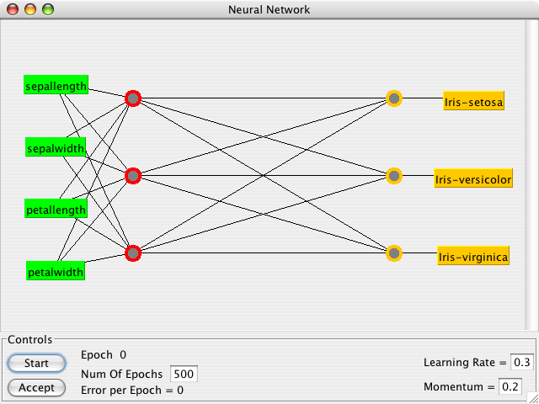

Slide 70
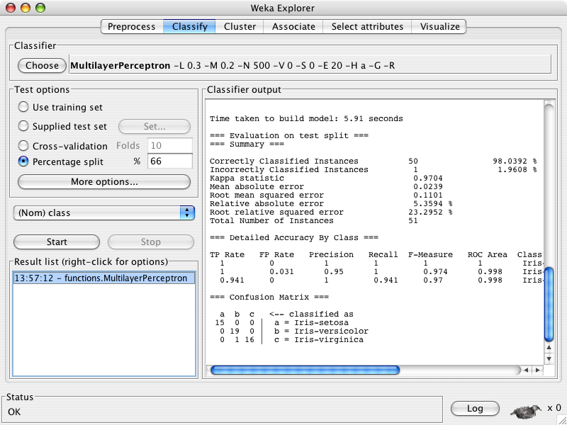

Slide 71
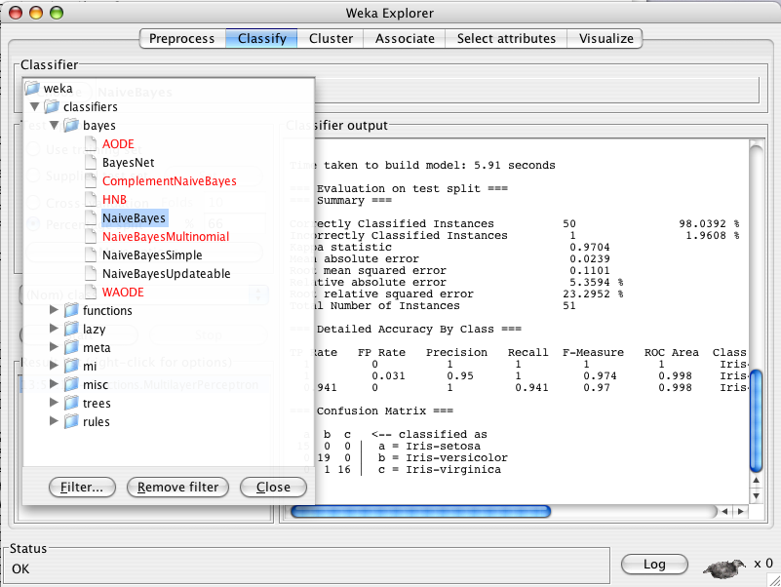

Slide 72
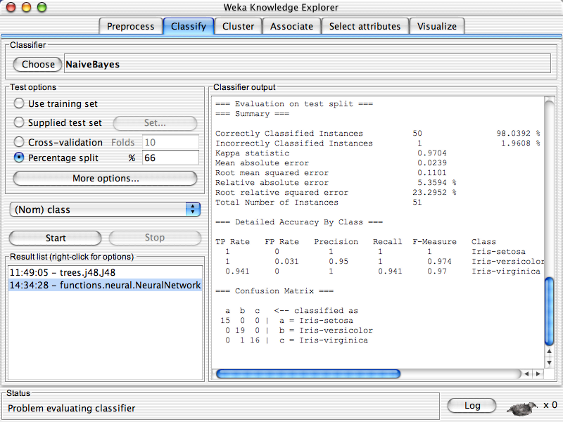

Slide 74
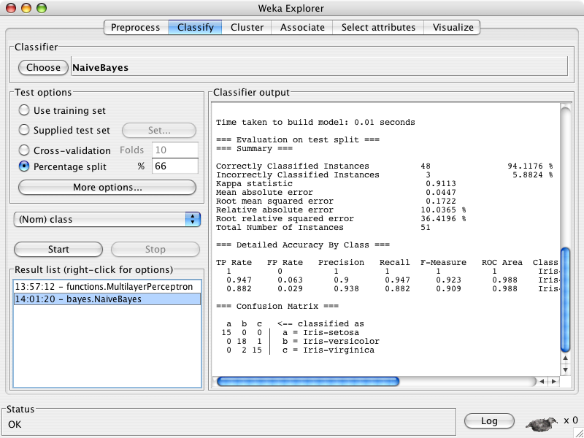

Slide 75
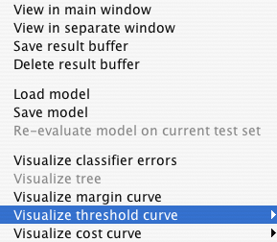


Slide 76
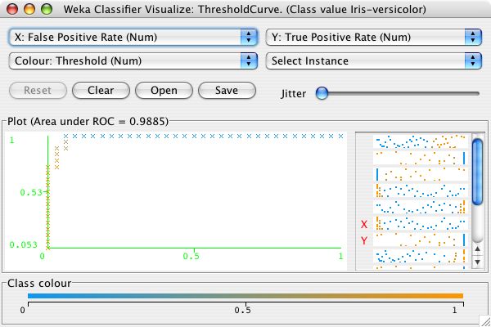

Slide 77
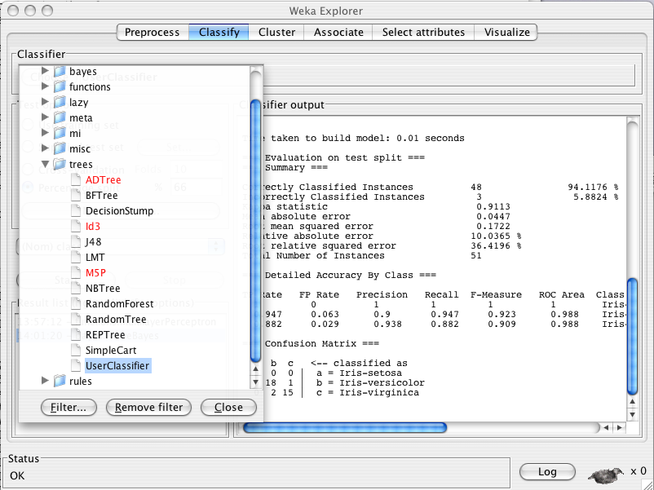

Slide 78
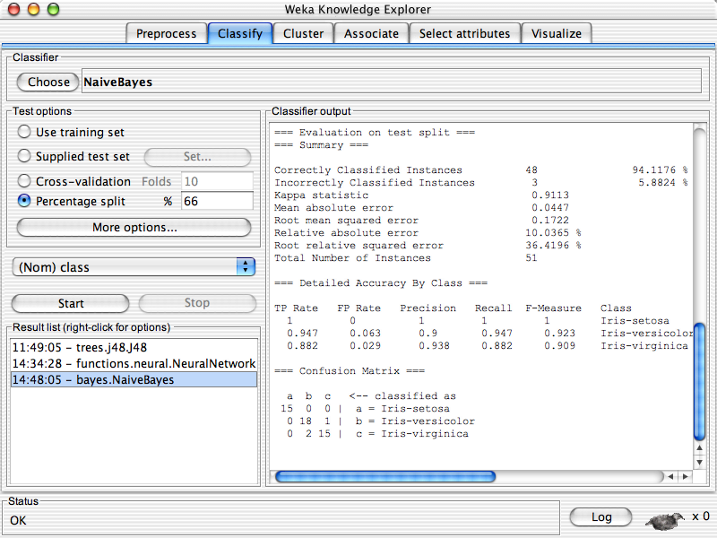

Slide 79
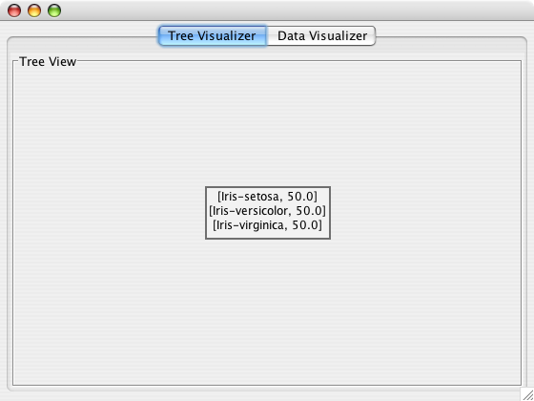

Slide 80
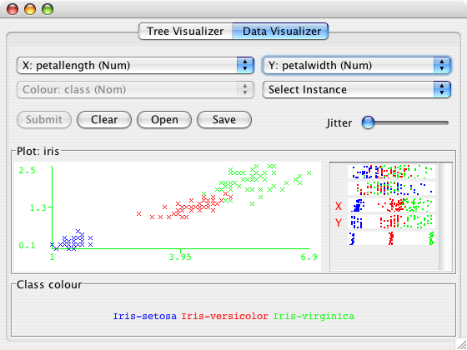

Slide 81
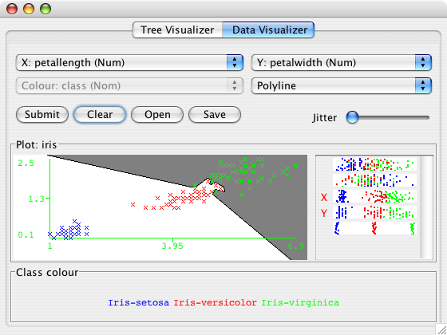

Slide 82
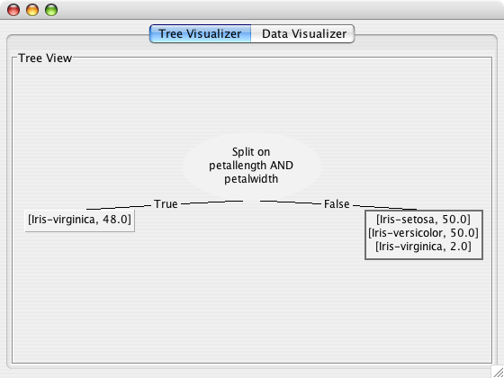

Slide 83
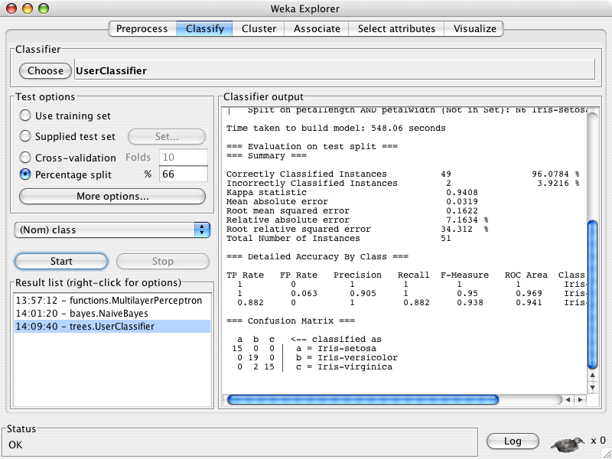

Slide 85
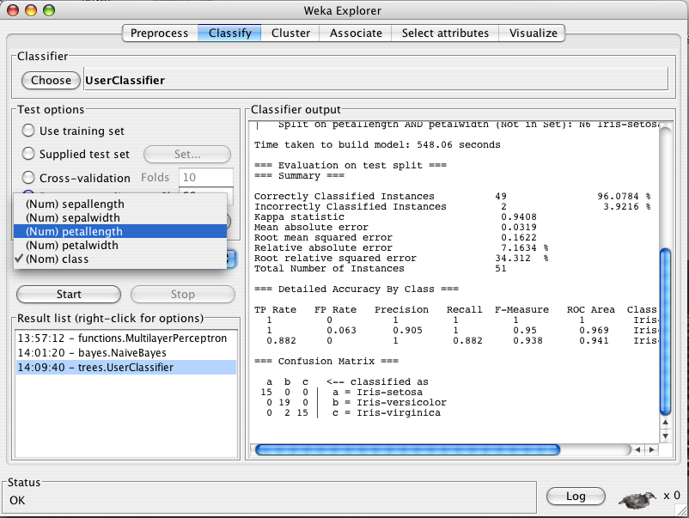

Slide 86


Slide 87


Slide 88


Slide 89


Slide 90


Slide 92


Slide 93
Explorer: clustering data
WEKA contains “clusterers” for finding groups of similar instances in a dataset
Some implemented schemes are:
  k-Means, EM, Cobweb, X-means, FarthestFirst
Clusters can be visualized and compared to “true” clusters (if given)
Evaluation based on loglikelihood if clustering scheme produces a probability distribution

Slide 94


Slide 95


Slide 96


Slide 97


Slide 98


Slide 99


Slide 100


Slide 101


Slide 102


Slide 103
Explorer: finding associations
WEKA contains the Apriori algorithm (among others) for learning association rules
  Works only with discrete data
Can identify statistical dependencies between groups of attributes:
  milk, butter ⇒ bread, eggs (with confidence 0.9 and support 2000)
Apriori can compute all rules that have a given minimum support and exceed a given confidence

Slide 104


Slide 105


Slide 106


Slide 107
Explorer: attribute selection
Panel that can be used to investigate which (subsets of) attributes are the most predictive ones
Attribute selection methods contain two parts:
  A search method: best-first, forward selection, random, exhaustive, genetic algorithm, ranking
  An evaluation method: correlation-based, wrapper, information gain, chi-squared, …
Very flexible: WEKA allows (almost) arbitrary combinations of these two

Slide 108


Slide 109


Slide 111


Slide 112


Slide 113


Slide 114
Explorer: data visualization
Visualization very useful in practice: e.g. helps to determine difficulty of the learning problem
WEKA can visualize single attributes (1-d) and pairs of attributes (2-d)
  To do: rotating 3-d visualizations (Xgobi-style)
Color-coded class values
“Jitter” option to deal with nominal attributes (and to detect “hidden” data points)
“Zoom-in” function

Slide 115


Slide 116


Slide 118


Slide 119


Slide 120


Slide 121


Slide 122


Slide 125
Performing experiments
Experimenter makes it easy to compare the performance of different learning schemes
For classification and regression problems
Results can be written into file or database
Evaluation options: cross-validation, learning curve, hold-out
Can also iterate over different parameter settings
Significance-testing built in!

Slide 126


Slide 127


Slide 128


Slide 129


Slide 130


Slide 131


Slide 132


Slide 133


Slide 136
The Knowledge Flow GUI
Java-Beans-based interface for setting up and running machine learning experiments
Data sources, classifiers, etc. are beans and can be connected graphically
Data “flows” through components: e.g.,
“data source” -> “filter” -> “classifier” -> “evaluator”
Layouts can be saved and loaded again later
cf. Clementine ™

Slide 137


Slide 138


Slide 139


Slide 140


Slide 141


Slide 142
Can continue this...

Slide 143


Slide 144


Slide 145


Slide 146


Slide 147


Slide 148


Slide 149


Slide 152

Sourceforge.net – Downloads

Slide 153

Sourceforge.net – Web Traffic
WekaDoc Wiki introduced – 12/2005
WekaWiki launched – 05/2005

Slide 154
Projects based on WEKA
45 projects currently (30/01/07) listed on the WekaWiki
Incorporate/wrap WEKA
  GRB Tool Shed - a tool to aid gamma ray burst research
  YALE - facility for large scale ML experiments
  GATE - NLP workbench with a WEKA interface
  Judge - document clustering and classification
  RWeka - an R interface to Weka
Extend/modify WEKA
  BioWeka - extension library for knowledge discovery in biology
  WekaMetal - meta learning extension to WEKA
  Weka-Parallel - parallel processing for WEKA
  Grid Weka - grid computing using WEKA
  Weka-CG - computational genetics tool library

Slide 155
WEKA and PENTAHO
Pentaho – The leader in Open Source Business Intelligence (BI)
September 2006 – Pentaho acquires the Weka project (exclusive license and SF.net page)
Weka will be used/integrated as data mining component in their BI suite
Weka will be still available as GPL open source software
Most likely to evolve 2 editions:
  Community edition
  BI oriented edition

Slide 156
Limitations of WEKA
Traditional algorithms need to have all data in main memory
==> big datasets are an issue
Solution:
  Incremental schemes
  Stream algorithms
  MOA “Massive Online Analysis”
  (not only a flightless bird, but also extinct!)

Slide 157
Conclusion: try it yourself!
WEKA is available at
http://www.cs.waikato.ac.nz/ml/weka
Also has a list of projects based on WEKA
(probably incomplete list of) WEKA contributors:
Abdelaziz Mahoui, Alexander K. Seewald, Ashraf M. Kibriya, Bernhard Pfahringer, Brent Martin, Peter Flach, Eibe Frank, Gabi Schmidberger, Ian H. Witten, J. Lindgren, Janice Boughton, Jason Wells, Len Trigg, Lucio de Souza Coelho, Malcolm Ware, Mark Hall, Remco Bouckaert, Richard Kirkby, Shane Butler, Shane Legg, Stuart Inglis, Sylvain Roy, Tony Voyle, Xin Xu, Yong Wang, Zhihai Wang

